Slide 1



Mrs. Stonewall
Online Learning for March-April 2020

Slide 2
Enjoy the time you have together.
Families,
Keep it simple! Do what works for you. A routine really helps in my personal household. While I will be helping students with distance learning, please remember to reach out if you any need support. Together we will get through this!

Slide 3

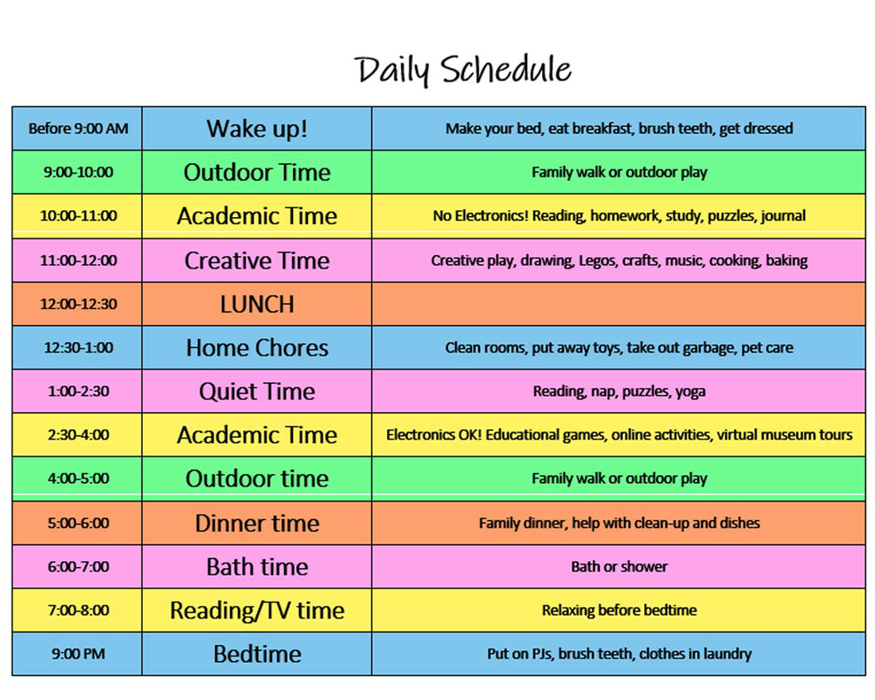

This image is from a posting I saw this weekend. This is just a suggestion, you can modify it however you like. ☺

Slide 4
Week 1
Let’s keep it simple: This week I want you to create a learning space for yourself. Keep all your supplies and books in one area: A basket or box will work if you are using the kitchen table or sharing the space with siblings.
Complete your weekly worksheet pages for reading and math.

Slide 5
Reflect and Share week 2
Now, let’s do a Tech Check:
Can you log into email?
Can you open canvas?
Are your families getting my emails?
I would like you to email me, or call me 360.602.9776 and leave a message saying what you are able to do!
I will be calling families this week to make sure needs are being met.
Think about last week...
How do you feel about being out of the classroom?
What have you been doing to stay busy?

Slide 6
Week 3
Tuesdays and Thursday’s at 2:00 pm I will host a zoom webinar. This will help us to connect and give you the opportunity to ask questions. Click the zoom like below to join the meeting. ☺ https://everettsd.zoom.us/j/457716082?pwd=OWQ2V1h3dzN3VXc2TFB5aHFWREF2dz09
This week, the Everett School district will be sending out homework packets. If you do not receive a packet, please let me know. The link below will guide you to the printable resource that are in packet. https://www.everettsd.org/Page/31233

Slide 7
ZOOM conferencing
Once you click on the provided URL for the meeting, Zoom will ask you if you would like to download Zoom application or joining the meeting using your web browser.
click on “Download and Run Zoom” and follow the prompts on your computer to install and run the app.
The Zoom app will automatically download to your computer . From your dashboard click on “Join” button.
Then enter meeting’s URL into the pop up window.
How to participate in the virtual meeting using Zoom
Zoom URL:
https://everettsd.zoom.us/j/457716082?pwd=OWQ2V1h3dzN3VXc2TFB5aHFWREF2dz09

Slide 8
Support for Families
Salvation Army Food Bank
Location: 2525 Rucker Ave, Everett
Hours: Monday and Friday 10 AM-1 PM
Tuesday, Wednesday, and Thursday 10 AM-3 PM
Info: 425-259-8129
www.everett.salvationarmy.org
VOA Food Bank
Location: 1230 Broadway, Everett
Hours: Monday, Wednesday, and Thursday 10 AM-1 PM
Tuesday 3-6PM
Info: 425-259-3191
www.voaww.org/foodbank
Meals for children up to age 18 at any school, it does not have to be the one they attend or even in the same district, and walk ups are allowed
Will be available for curbside pick-up from 11:30 a.m. - 12:45 p.m. at:
Evergreen Middle School
Cedar Wood Elementary School
Garfield Elementary School
Hawthorne Elementary School
Jefferson Elementary School
Lowell Elementary School
Silver Lake Elementary School

